Slide 1
Master Thesis Presentation Reporting Practices on Software Engineering Books - A Sequential Mixed- method Approach
Balázs Lázár
^{Dr. Kate Revoredo}

Slide 2

Agenda
Problem and Research Aim
Methodology
Results Found
Discussion and Implications

Slide 3
Problem and Research Aim
Software Engineering (SE) is one of the most essential pillars of the area Information Systems (IS); however, future research is limited through the following issues:
Poor interpretation of research or study results
Several studies are organised in a variety of sections and chronological orders -> difficult search for specific information
Lack of reporting standards
SE books provide a source of knowledge for the application of SE; therefore, their correct interpretation and targeted search strategies can aid in locating relevant information more rapidly

Slide 4
Research Questions
RQ1 - How do SE textbooks relate to each other?
RQ2 - How are SE key terms addressed in SE textbooks?

Slide 5
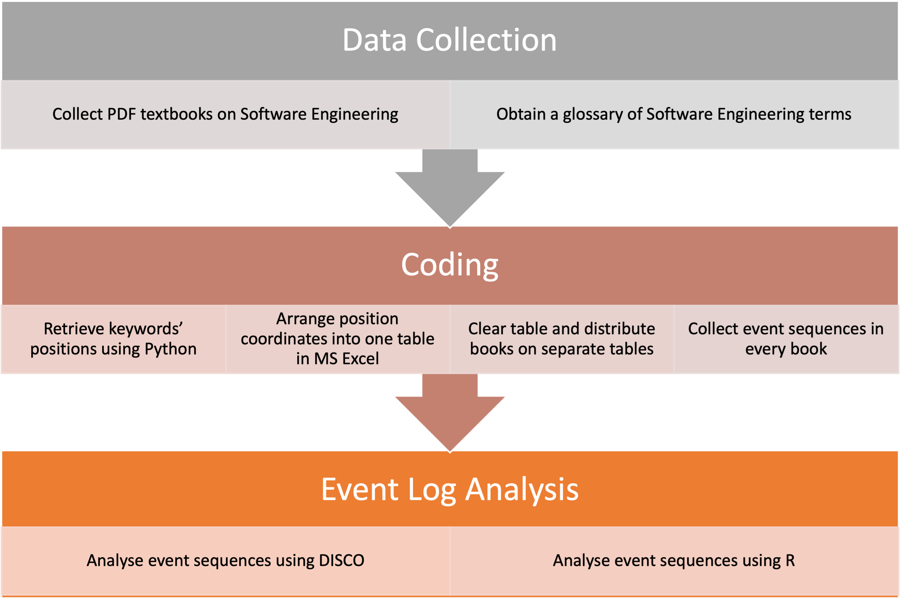
Methodology
Exploratory Sequential Mixed Method Design
Qualitative Analysis
Quantitative Analysis
John W Creswell. Qualitative, quantitative and mixed methods approaches, 2014.

Slide 6
Methodology – Qualitative Approach – Data Collection
Acquire set of books for the analysis
Initial query in Google Scholar -> 253 books
207 books regarded to Software Engineering
Inclusion Criteria
Format must be book
Topic relates to Software Engineering
Book published after 2004
Exclusion Cirteria
Articles and Reports
Full text not available
Full text not available in English
Books published before 2004
Final set – 36 books
From two different Publishers:
Morgan & Claypool Publishers
Springer Science & Business Media

Slide 7
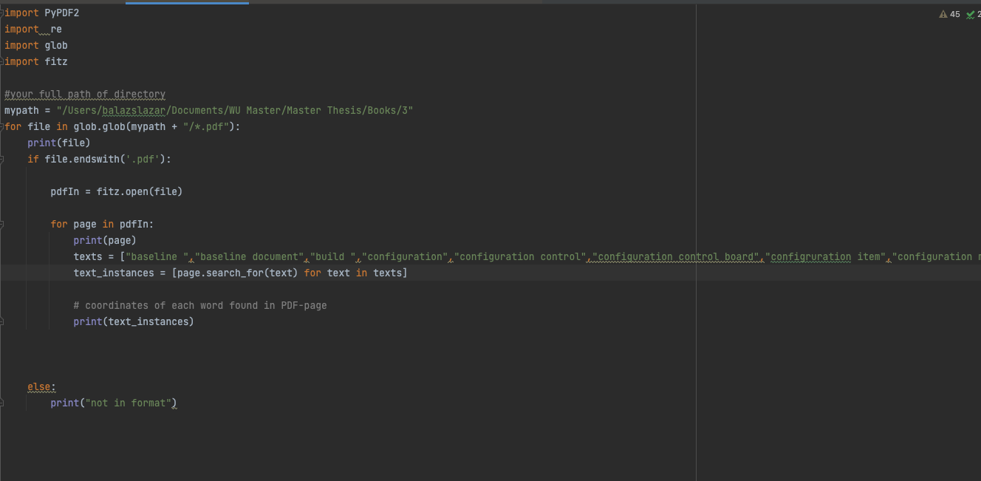
Methodology – Qualitative Approach – Coding
Retrieve keywords’ position using Python

Slide 8

Methodology – Qualitative Approach – Coding (2)
2. Arrange position coordinates into one table in MS Excel
3. Clear table and distribute books on separate tables
4. Collect event sequences from every book

Slide 9
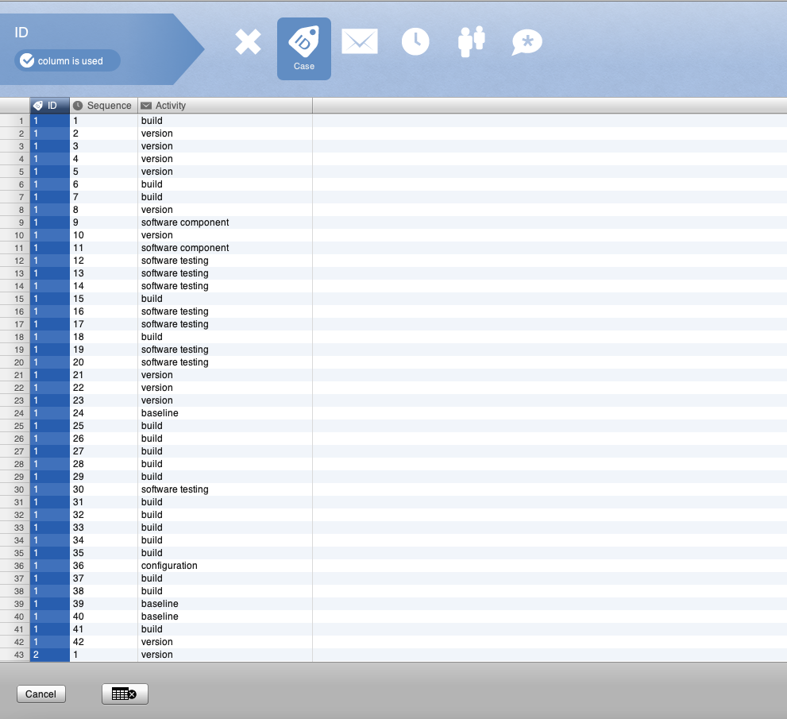
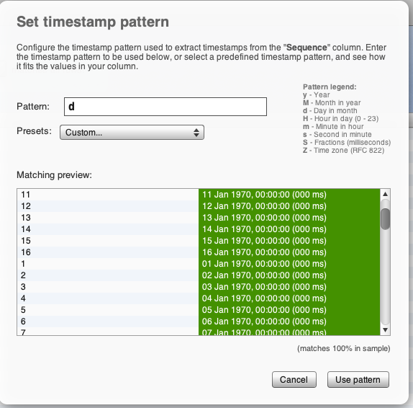
Methodology – Quantitative Approach – Event Sequence Analysis with DISCO

Slide 10
Methodology – Quantitative Approach – Event Sequence Analysis with R
Event Sequence Analysis – TramineR
Converting activities into state sequence objects
Create substitution-cost matrix
36 by 36 table – illustrates differences betweeen sequences when compared pairwise
“Seqdist” - ”LCS” dissimilarity matrix – measuring replacement costs
Clustering
Determine the number of optimal clusters
Visualise with the functions “seqplot” and “seqtree”

Slide 11
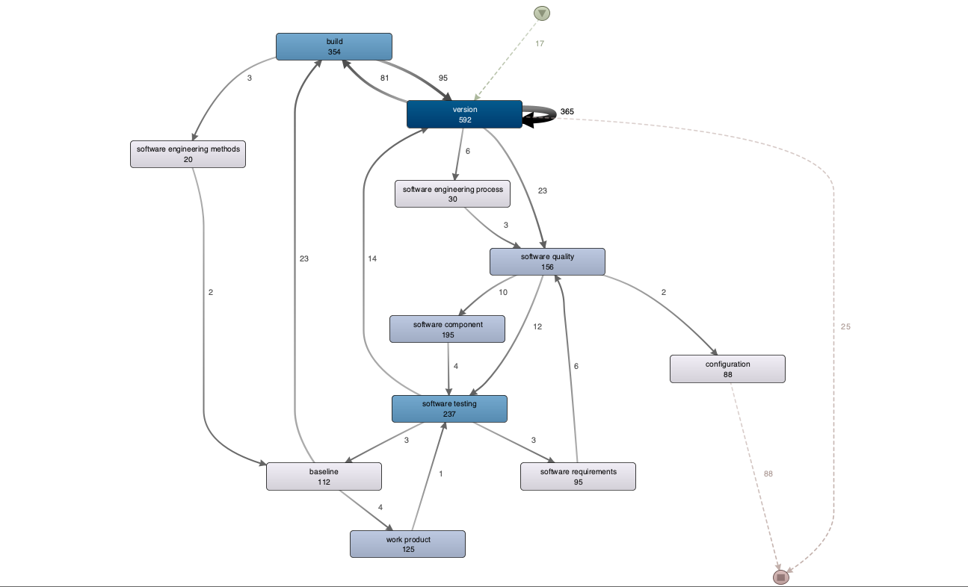
Results - DISCO

Slide 12
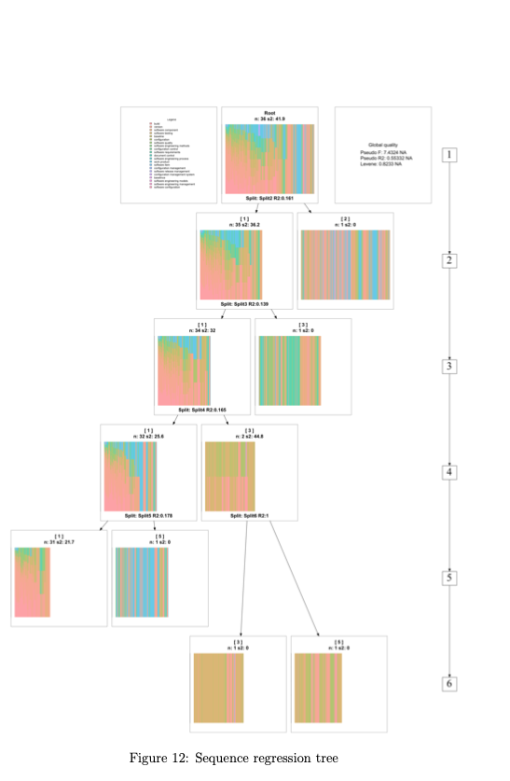
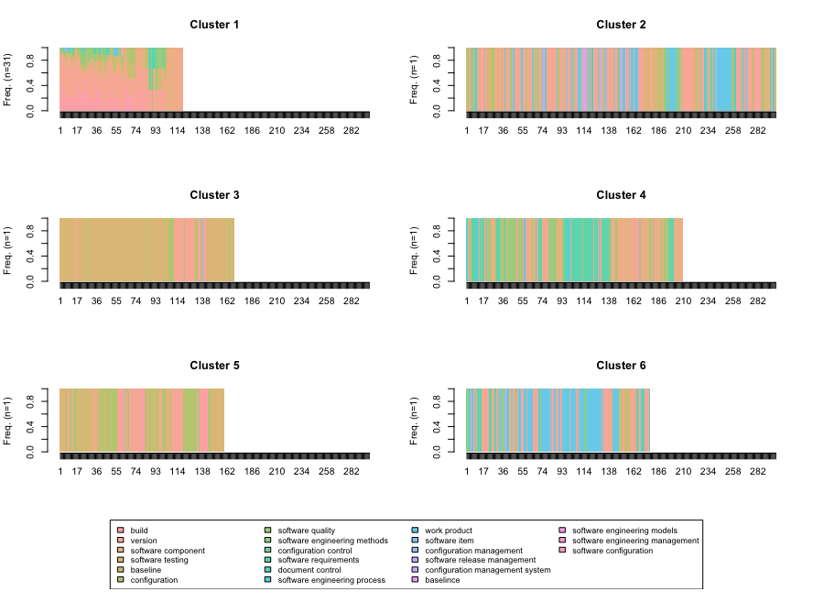
Results - R

Slide 13
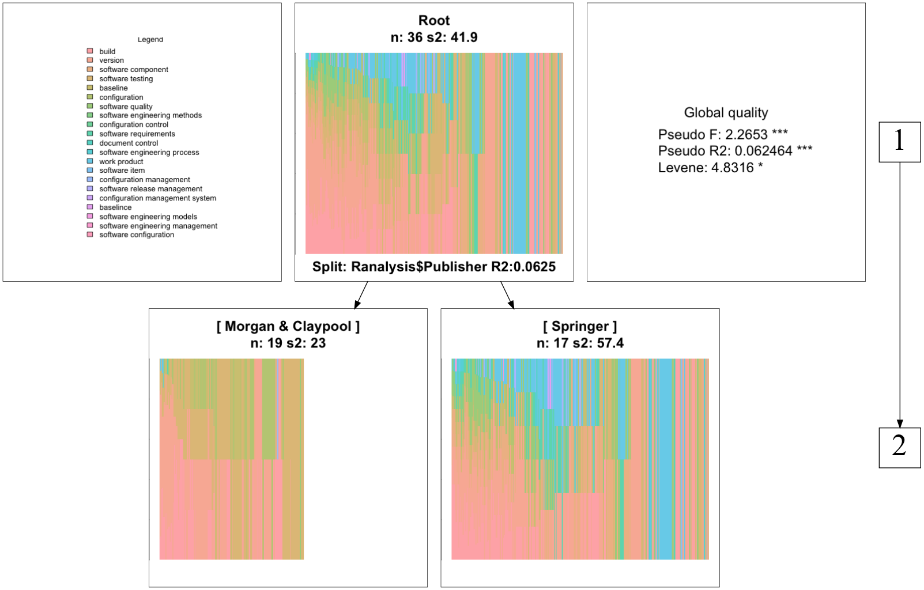
Results – R (2)

Slide 14
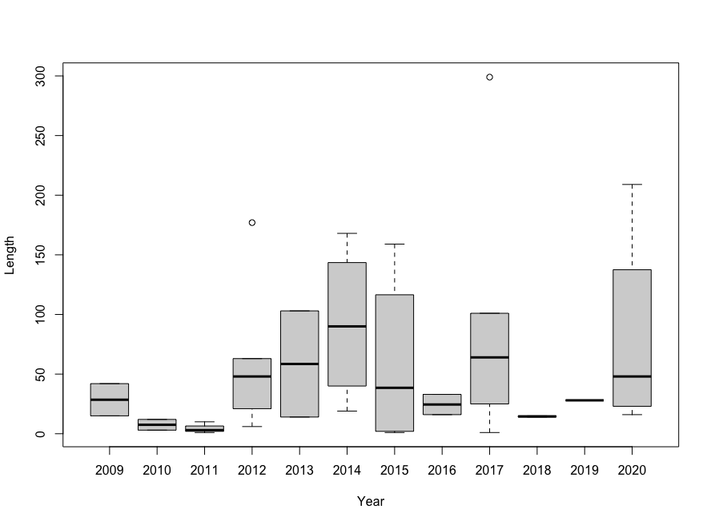
Results - R (3)

Slide 15
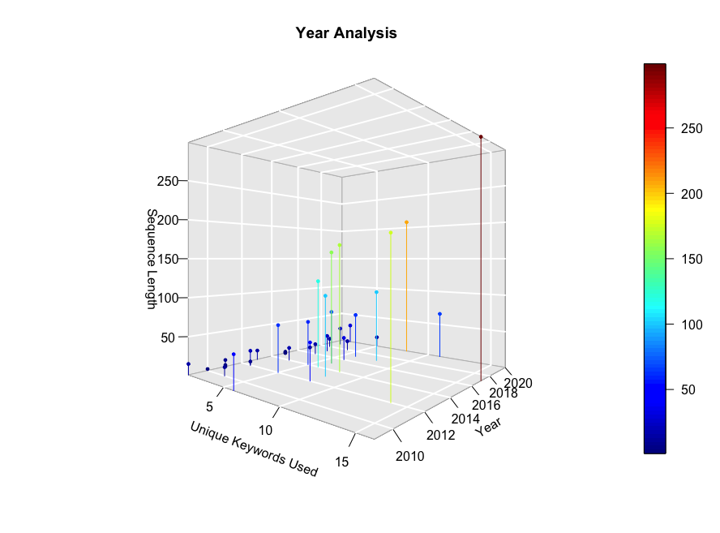
Results - R (4)

Slide 16
Discussion
Answers to RQ1:
Five clusters that contain one book: have relatively larger sequence lengths with greater variety of found SE key terms.
The rest 31 books had relatively short sequence length
Answers to RQ2:
In total, 41 keywords were investigated; only 21 were represented in the books
Most frequently mentioned key words: “build”, “version”

Slide 17
Discusssion (2)
Limitations
Textbooks: relatively small set of books were available in full version
Coding: Strong interconnected realiability of data
SE Glossary: Source was published in 2003; has relatively low citation
Implications for further research:
Investigating larger set of books might be relevant
Investigate highly cited glossary including more key terms

Slide 18
Thank you for your attention!

